Slide 1
Help desk
Muhamad ilham habibie
Muhammad Iqbal aula rahman

Slide 2
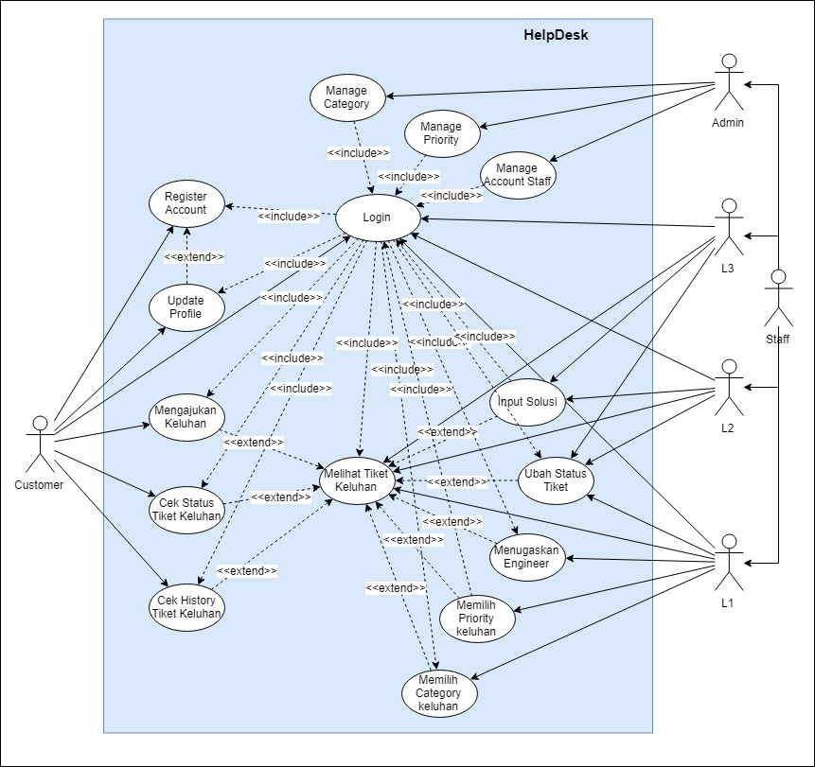
Use case

Slide 3
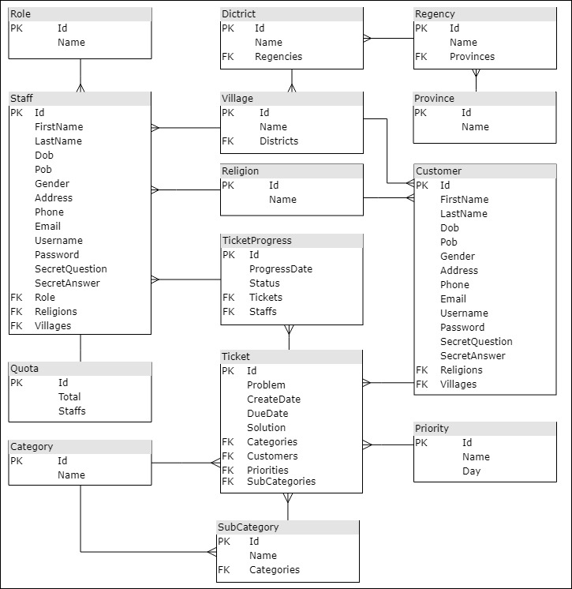
erd

Slide 4
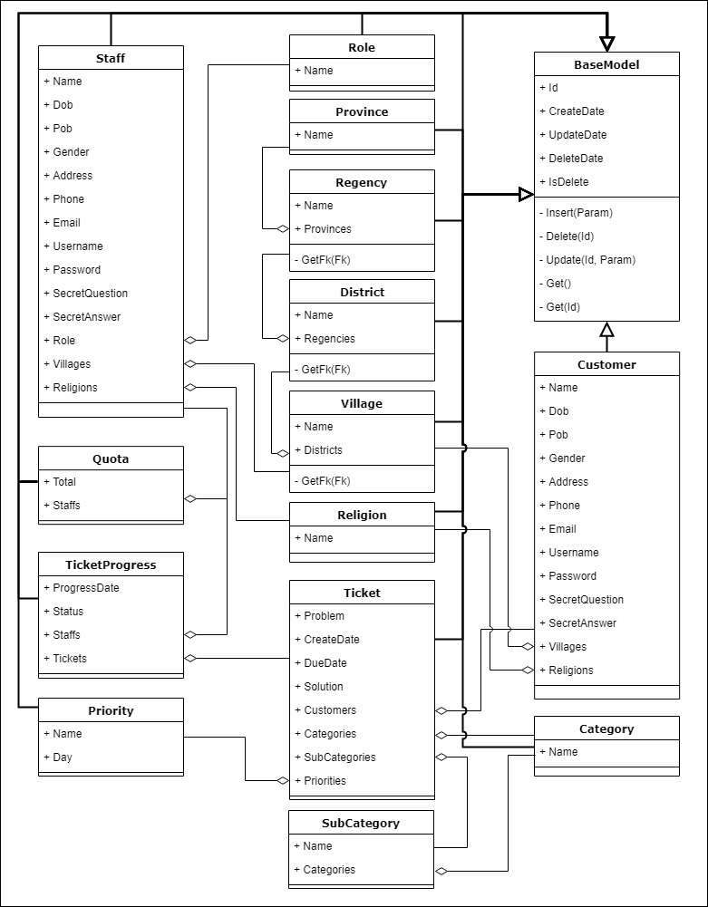
Class

Slide 5
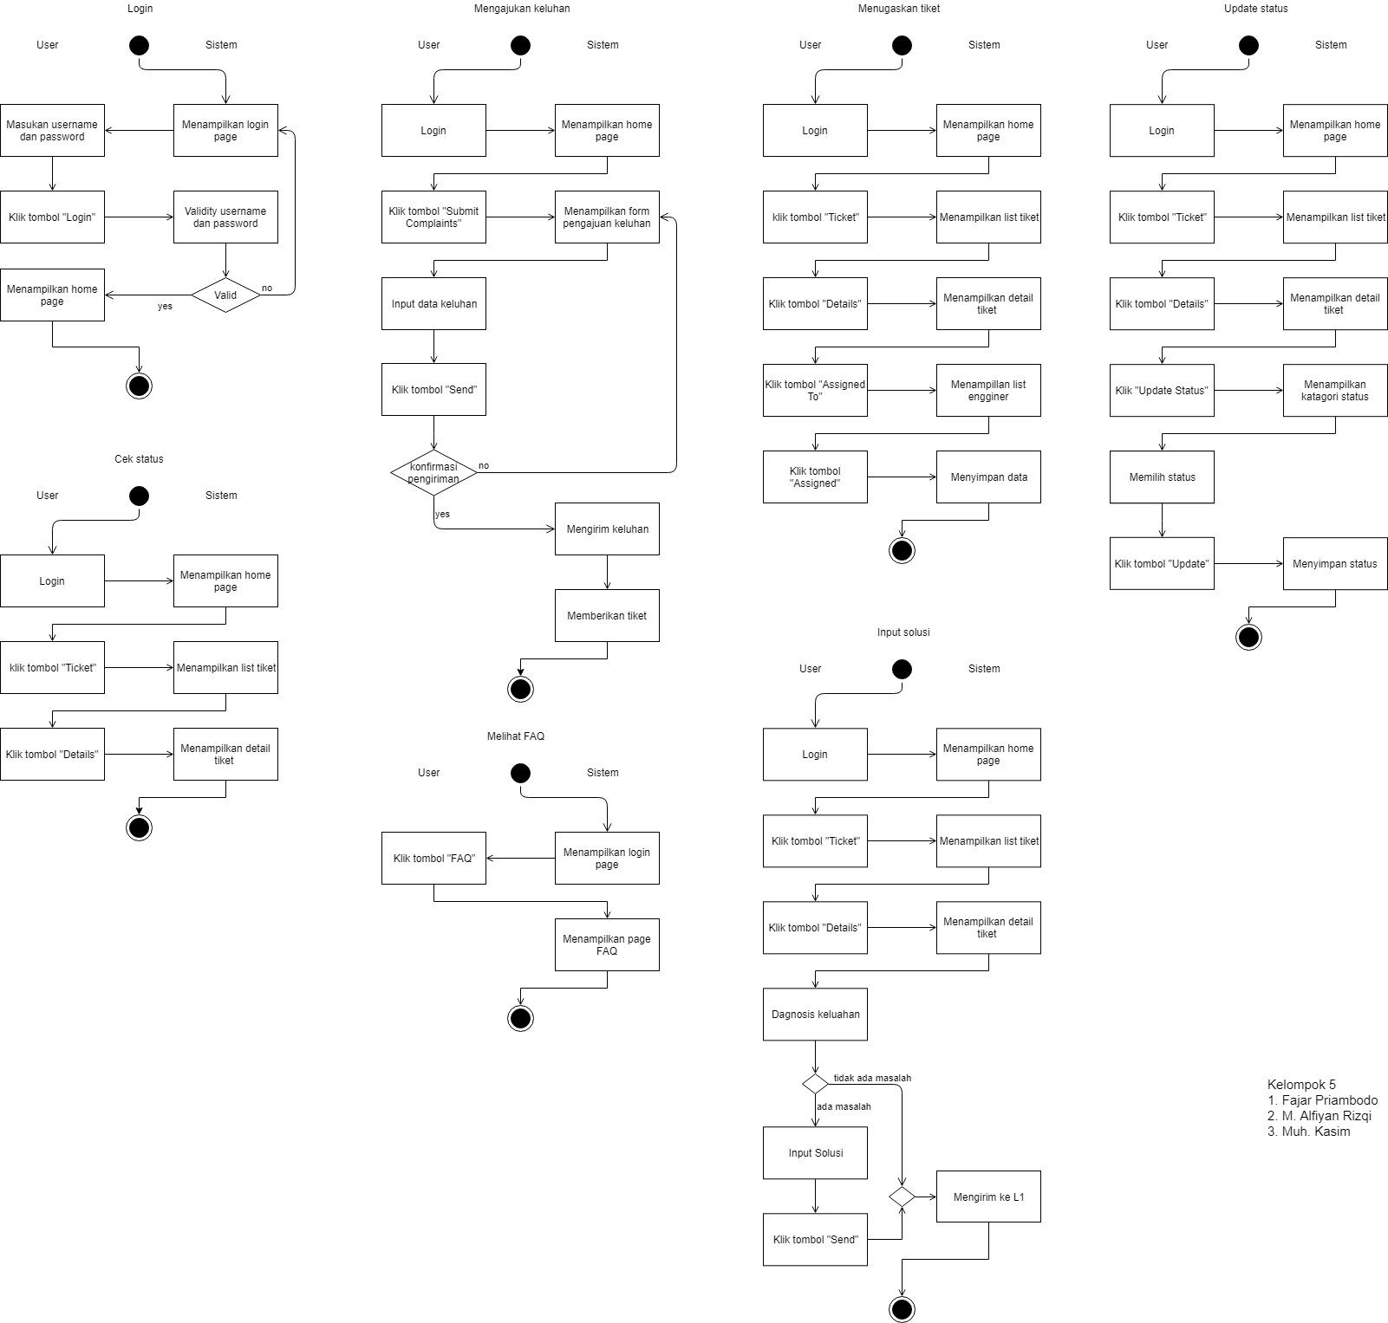
Activity

Slide 6
Help desk web api asp.net

Slide 7
Thank you...

